Slide 1
Efficient Reasoning: Long2Short
Reporter: Bin Hong
State Key Laboratory of Cognitive Intelligence

Slide 2
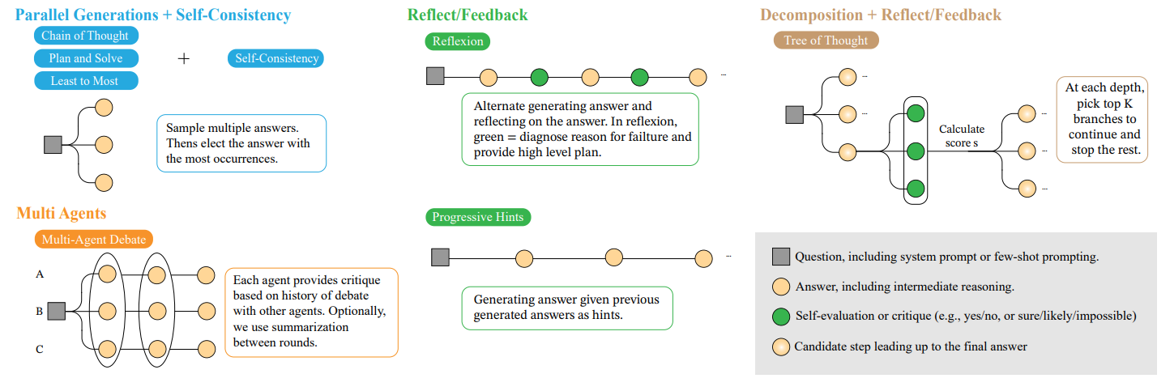
概览
Background
Test-Time Scaling
模型表现随着使用 tokens 数目增长而增长的现象
Parallel Methods: Self-Consistency, Weighted majority voting
Sequential Methods: CoT, Self-refinement
Overlong Output and Overthinking
State Key Laboratory of Cognitive Intelligence
Notes:
Self-Consistency: Wang, Xuezhi, et al. "Self-consistency improves chain of thought reasoning in language models." arXiv preprint arXiv:2203.11171 (2022).
Weighted majority voting: Wang, Peiyi, et al. "Math-shepherd: Verify and reinforce llms step-by-step without human annotations." arXiv preprint arXiv:2312.08935 (2023).
CoT: Wei, Jason, et al. "Chain-of-thought prompting elicits reasoning in large language models." Advances in neural information processing systems 35 (2022): 24824-24837. Self-refinement: Kumar, Aviral, et al. "Training language models to self-correct via reinforcement learning." arXiv preprint arXiv:2409.12917 (2024).
图片来源: Wang, Junlin, et al. "Reasoning in token economies: Budget-aware evaluation of llm reasoning strategies." arXiv preprint arXiv:2406.06461 (2024).

Slide 3
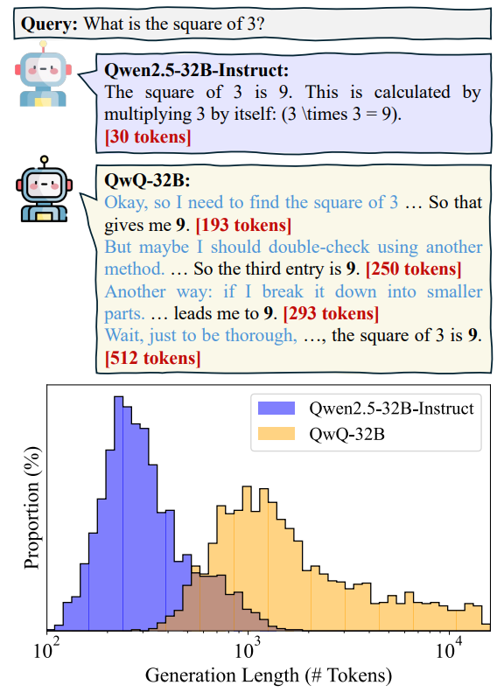
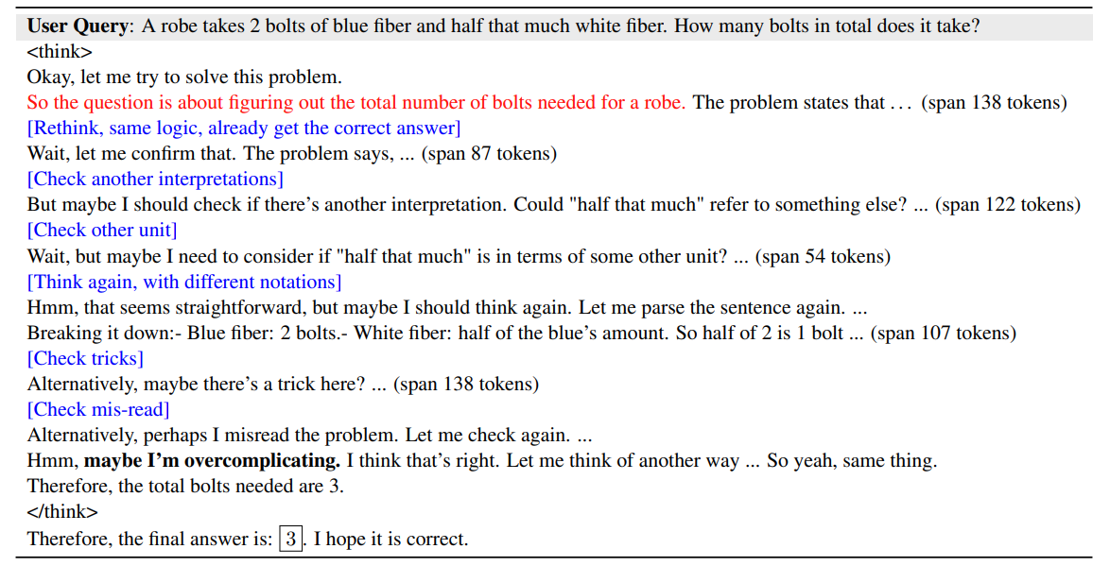
概览
Background
Test-Time Scaling
模型表现随着使用 tokens 数目增长而增长的现象
Parallel Methods: Self-Consistency, Weighted majority voting
Sequential Methods: CoT, Self-refinement
Overlong Output and Overthinking
State Key Laboratory of Cognitive Intelligence
Notes:
Self-Consistency: Wang, Xuezhi, et al. "Self-consistency improves chain of thought reasoning in language models." arXiv preprint arXiv:2203.11171 (2022).
Weighted majority voting: Wang, Peiyi, et al. "Math-shepherd: Verify and reinforce llms step-by-step without human annotations." arXiv preprint arXiv:2312.08935 (2023).
CoT: Wei, Jason, et al. "Chain-of-thought prompting elicits reasoning in large language models." Advances in neural information processing systems 35 (2022): 24824-24837. Self-refinement: Kumar, Aviral, et al. "Training language models to self-correct via reinforcement learning." arXiv preprint arXiv:2409.12917 (2024).
图片来源: Qu, Xiaoye, et al. "A survey of efficient reasoning for large reasoning models: Language, multimodality, and beyond." arXiv preprint arXiv:2503.21614 (2025).
一些说明 过长可能损害模型表现的工作，没有在 LLM 的 scaling 下验证（特定任务和简单 transformer 模型），于是没有放上来

Slide 4
概览
Background
Test-Time Scaling
好处：使得 Reasoning model 的表现一定程度上可控、可预测
Overthinking 的潜在定义？长度继续提升不再带来表现提升（模型的 Test-Time Scaling 能力边界）
坏处：推理效率差、训练显存需求高、成本高、限制下游应用
同样数据集 R1-Distill-Qwen-7B 比 Qwen-Math-7B-Instruct 慢得多（难度高的数据集可达 5-10 倍）
Qwen-Math-7B-Instruct 可四卡训练（原生长度 4096）
R1-Distill-Qwen-7B 无法以原生长度四卡训练（需要使用 offload + sequence parallel）
Planning 和 Reasoning 是 agent 应用的核心需求能力，限制应用开发
……
State Key Laboratory of Cognitive Intelligence

Slide 5
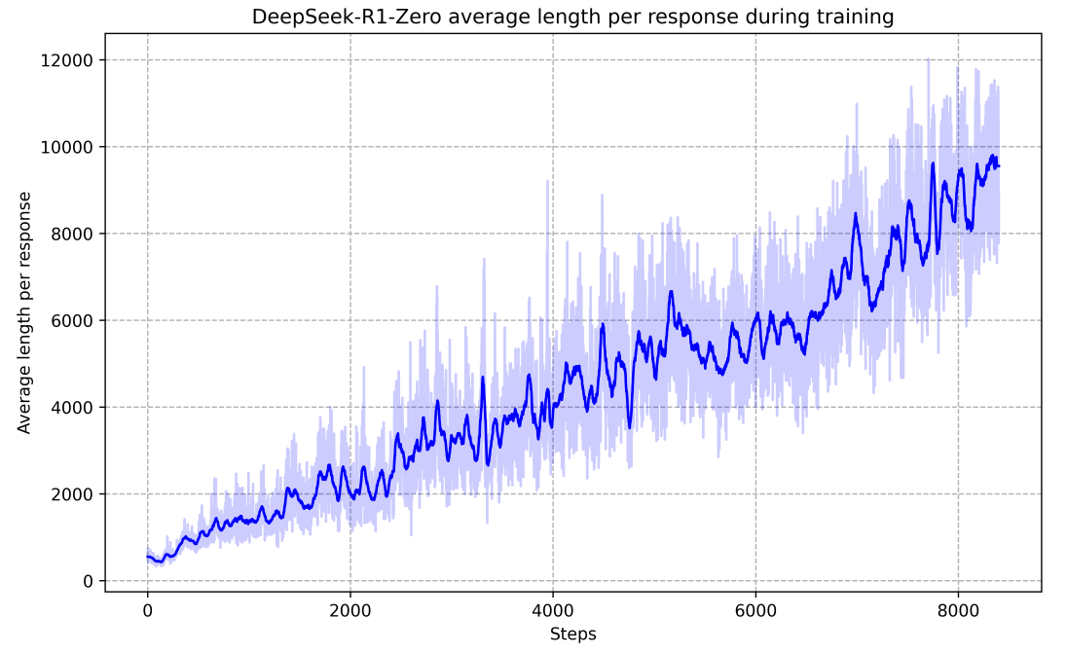
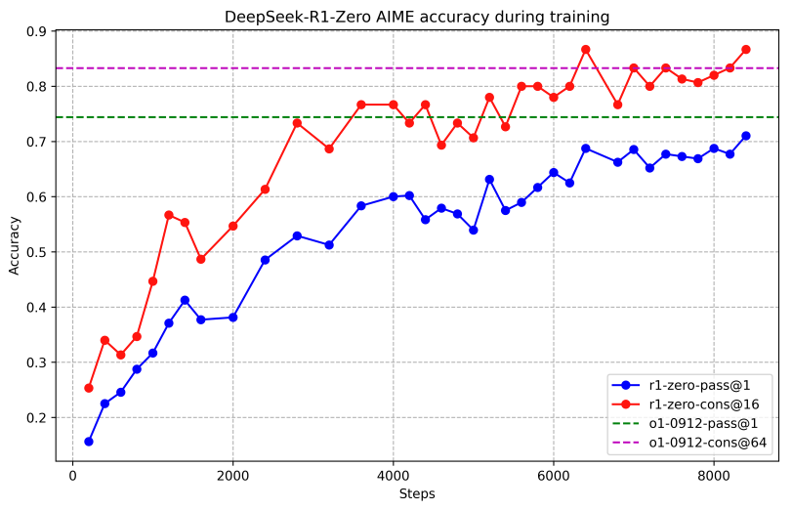
概览
Background
Reinforcement Learning
前置内容省略，主要是 offline 和 online 两种形式……
R1 技术报告展示出 RL 训练过程中的自然 Test-Time Scaling
State Key Laboratory of Cognitive Intelligence
Notes:
R1: Guo, Daya, et al. "Deepseek-r1: Incentivizing reasoning capability in llms via reinforcement learning." arXiv preprint arXiv:2501.12948 (2025).

Slide 6
概览
Long2Short
Efficient Reasoning
通过 RL 得到的模型展现出 RL 和 Test-Time Scaling 的强相关性
按 backbone LLM 的类型分类（两个大的研究问题）
如何让通过 RL 得到的模型在 Test-Time Scaling 和 推理表现之间 trade-off（on LRMs）
如何让模型在训练提升推理能力的同时不产生过度的 Test-Time Scaling（on LLMs）
按方法分类
Pre-training
Post-training: SFT/ Preference Optimization/ online-RL
Inference: Adaptive decoding/ Token Budget/ …
Model Merging
……
按写作分类
Adaptive Thinking
（与上面相对的）不涉及 Adaptive Thinking
…
State Key Laboratory of Cognitive Intelligence

Slide 7
概览
Long2Short
On LLMs
RL: Dr.GRPO, DAPO, Kimi1.5, AdaCoT
RL-based 的方法可以进一步按照数据（没见过）、算法、reward 分类
State Key Laboratory of Cognitive Intelligence
Notes:
有综述的分类涉及到：在小规模模型上（参数规模），模型输出，训练数据等维度的分类，但并不合理（比如小模型不一定输出高效，只是显存需求小而已，而且跟长输出带来的显存增加相比较小）

Slide 8
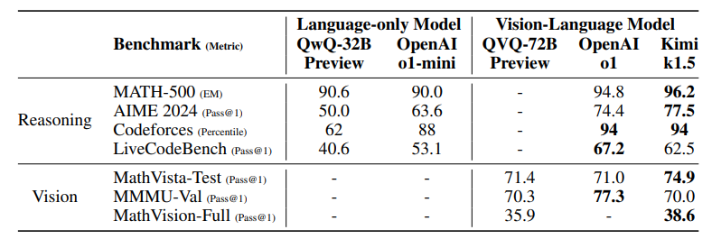
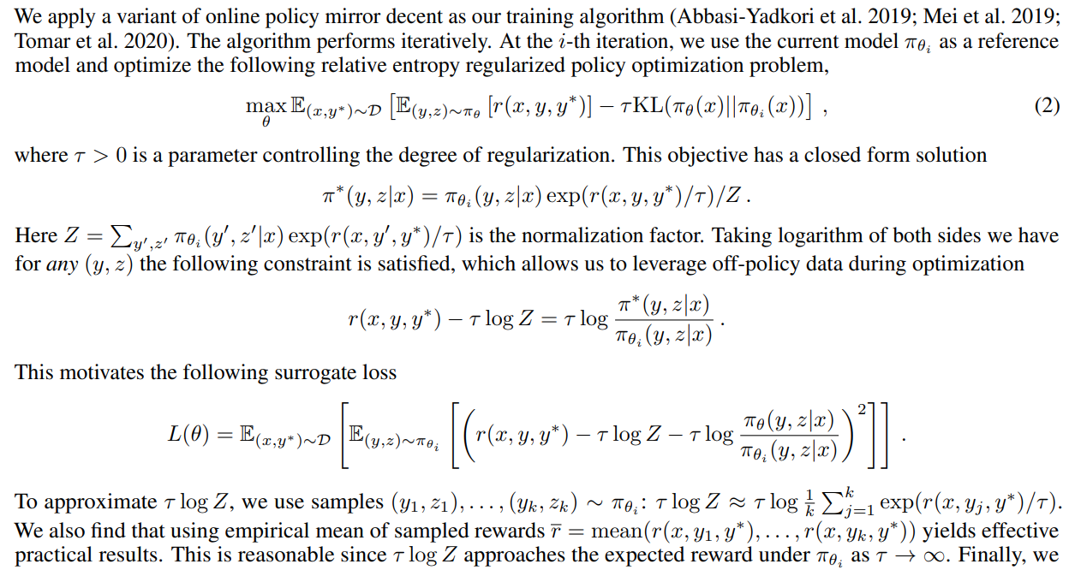
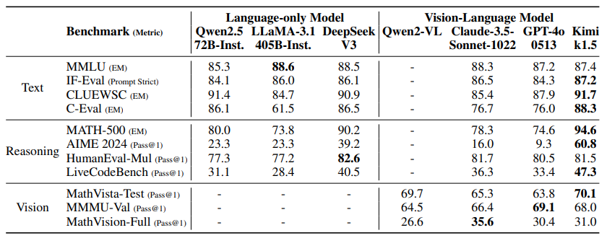
概览
Long2Short
On LLMs: RL-based
Dr.GRPO, DAPO (non-Adaptive): 分析并调整 objective 中含有 length bias 的部分
Kimi1.5 (non-Adaptive): Reward with Length Penalty （实际是 offline-RL）
State Key Laboratory of Cognitive Intelligence
Notes:
Dr.GRPO: Liu, Zichen, et al. "Understanding r1-zero-like training: A critical perspective." arXiv preprint arXiv:2503.20783 (2025).
DAPO: Yu, Qiying, et al. "Dapo: An open-source llm reinforcement learning system at scale." arXiv preprint arXiv:2503.14476 (2025).
Kimi1.5: Team, Kimi, et al. "Kimi k1. 5: Scaling reinforcement learning with llms." arXiv preprint arXiv:2501.12599 (2025).

Slide 9
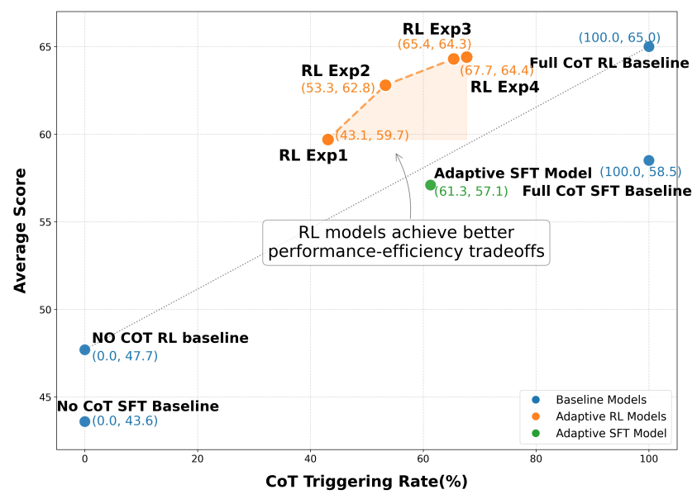
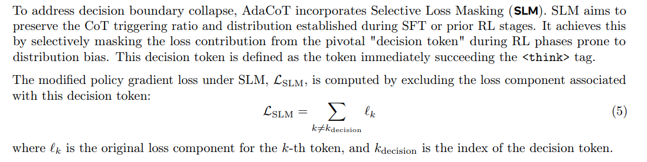
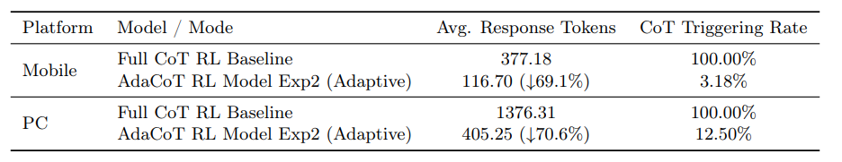
概览
Long2Short
On LLMs: RL-based
AdaCoT (Adaptive thinking)
显式构造 Pareto 边界的 Reward 设计
为了保持模型决策能力和分布，避免决策边界崩溃（始终触发 CoT 或始终不触发） 使用选择性 loss 掩码（Selective Loss Masking）
State Key Laboratory of Cognitive Intelligence
Notes:
AdaCoT: Lou, Chenwei, et al. “AdaCoT: Pareto-Optimal Adaptive Chain-of-Thought Triggering via Reinforcement Learning.” arXiv preprint arXiv:2505.11896 (2025). 区分是否进行 CoT 相当于一种隐式的 二分类，因此原文还使用了 F1-score 召回率、查准率等指标，这里没有列出

Slide 10
概览
Long2Short
On LRMs: Background: Token-Budget
SFT + online-RL: Qwen3
online-RL: L1, ThinkPrune, Adaptthink, Thinkless, HAPO…
offline-RL: DAST
State Key Laboratory of Cognitive Intelligence

Slide 11
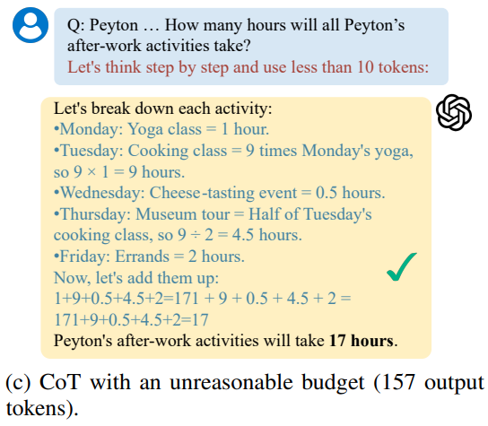
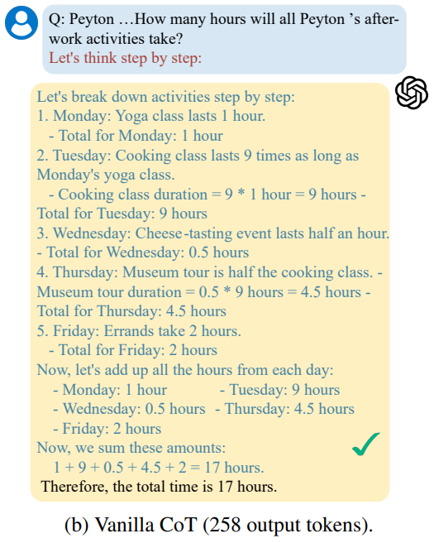
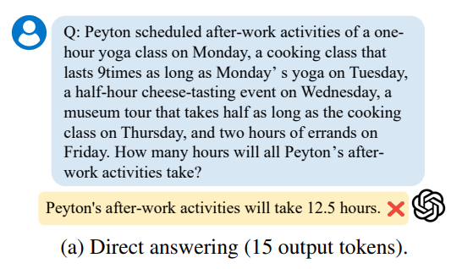
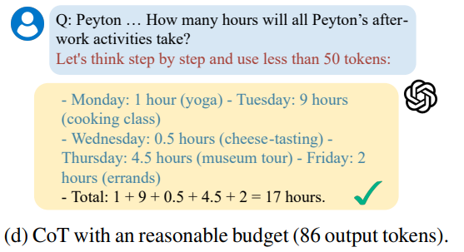
概览
Long2Short
On LRMs: SFT + online-RL
Background: Token-Budget
State Key Laboratory of Cognitive Intelligence
Notes:
图片来源: Han, Tingxu, et al. "Token-budget-aware llm reasoning." arXiv preprint arXiv:2412.18547 (2024).

Slide 12
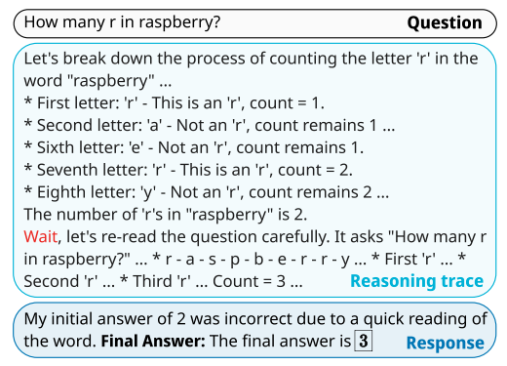
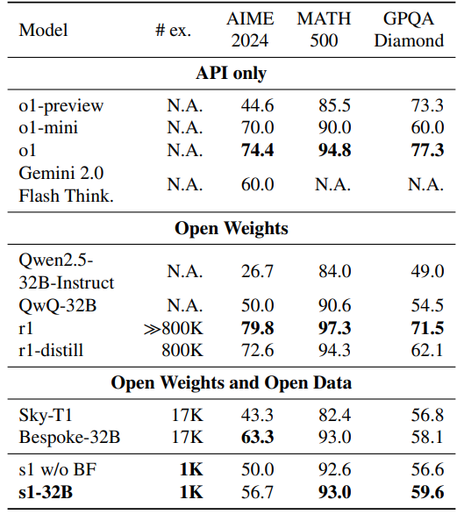
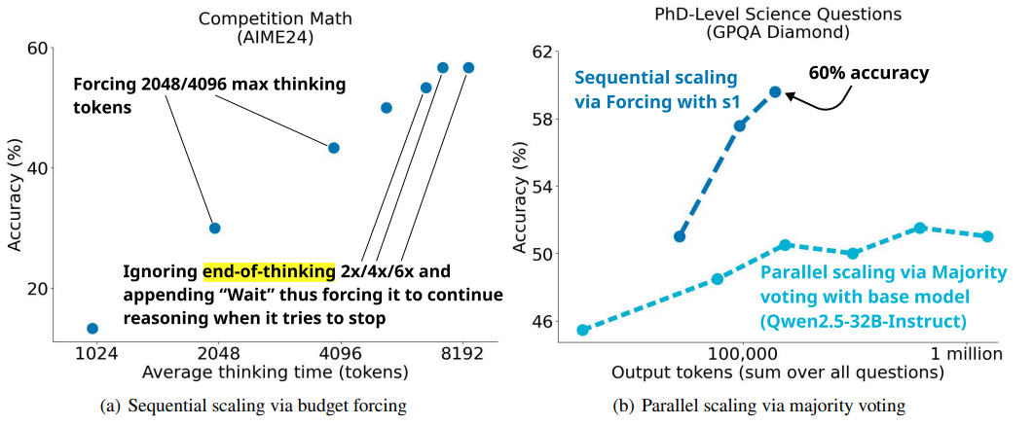
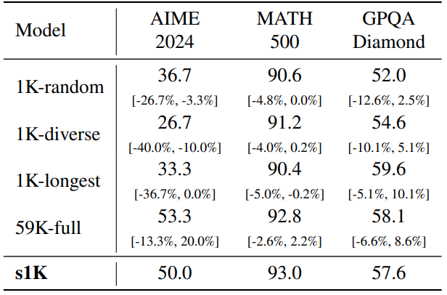
概览
Long2Short
On LRMs: SFT + online-RL
s1: Simple Test-Time Scaling
Budget forcing
手动增加 end-of-thinking token delimiter (“Final Answer:”) 终止思考
增加 “Wait” 引发 reflection
State Key Laboratory of Cognitive Intelligence
Notes:
s1: Muennighoff, Niklas, et al. "s1: Simple test-time scaling." arXiv preprint arXiv:2501.19393 (2025).

Slide 13
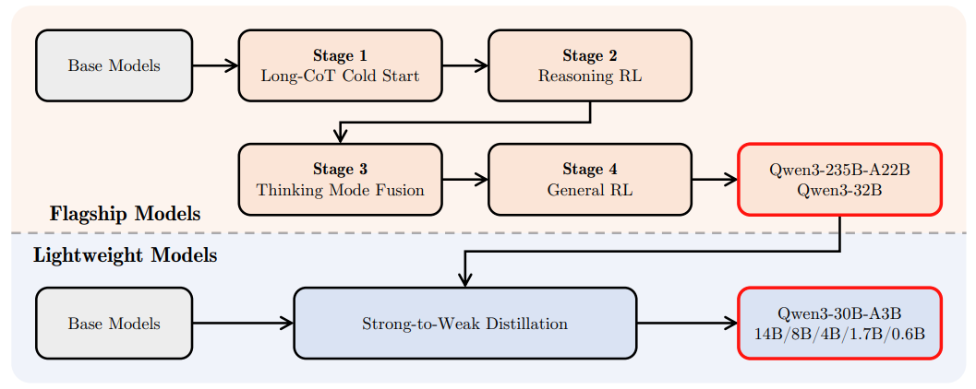
概览
Long2Short
On LRMs: SFT + online-RL
Qwen3
Thinking Control (Adaptive thinking)
Strong-to-Weak Distillation
State Key Laboratory of Cognitive Intelligence
Notes:
Qwen3: Yang, An, et al. "Qwen3 technical report." arXiv preprint arXiv:2505.09388 (2025).

Slide 14
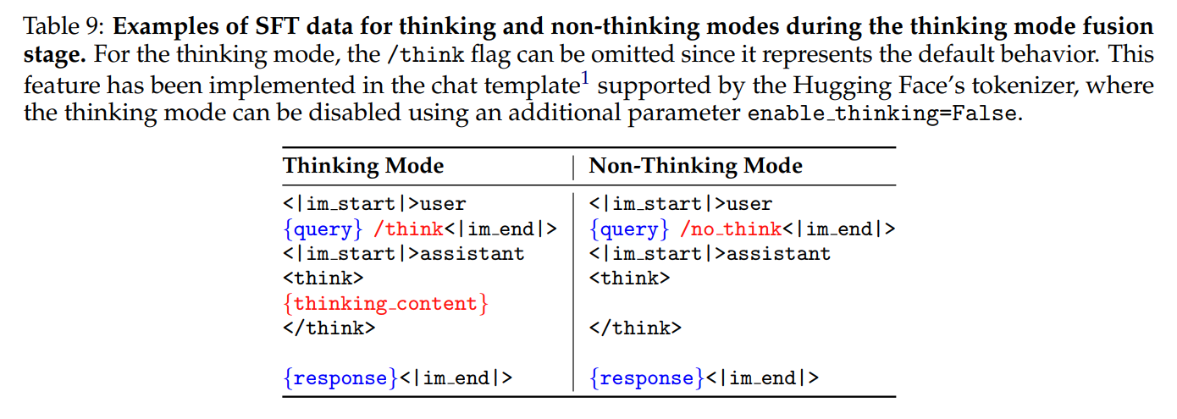
概览
Long2Short
On LRMs: SFT + online-RL
Mixed SFT Data:
Thinking data: 来自上一阶段通过 reasoning RL 得到的模型
Non-thinking data: 精心构造的涵盖多种任务的数据，通过 constitution AI 方法评估质量
Template trick：
插入特殊 token 控制是否思考
复杂多轮对话随机插入控制思考的 token
State Key Laboratory of Cognitive Intelligence
Notes:
Qwen3: Yang, An, et al. "Qwen3 technical report." arXiv preprint arXiv:2505.09388 (2025).
加一个讨论部分：模型能力提高，生成长度自然减少；Deepseek 展现出得 budget forcing 行为；给几个 Qwen3 的实例

Slide 15
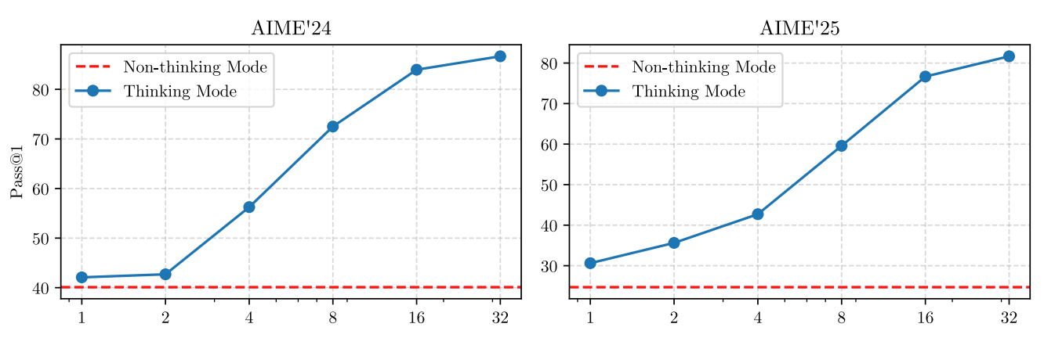
概览
Long2Short
On LRMs: SFT + online-RL
Thinking Budget
SFT 后模型自然具备基于不完整思考过程生成答案的问题
长度到达 budget 后强制中断思考并插入特殊语句： “Considering the limited time by the user, I have to give the solution based on the thinking directly now.\n</think>.\n\n”
State Key Laboratory of Cognitive Intelligence
Notes:
Qwen3: Yang, An, et al. “Qwen3 technical report.” arXiv preprint arXiv:2505.09388 (2025). 这里只放了数学指标的测评结果

Slide 16
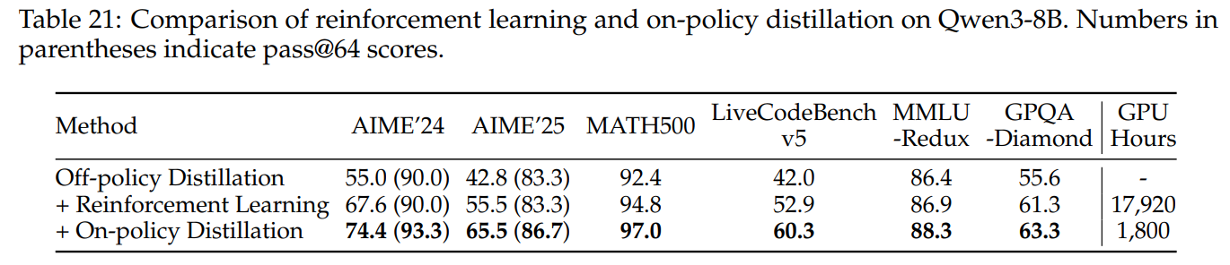
概览
Long2Short
On LRMs: SFT + online-RL
蒸馏小模型
Off-policy Distillation
On-policy Distillation: 小模型生成回复，对齐和大模型之间的 logit（降低 KL 散度）
State Key Laboratory of Cognitive Intelligence
Notes:
Qwen3: Yang, An, et al. “Qwen3 technical report.” arXiv preprint arXiv:2505.09388 (2025).
On-policy Distillation 这里写的比较简短，存在歧义 这里只放了数学指标的测评结果

Slide 17
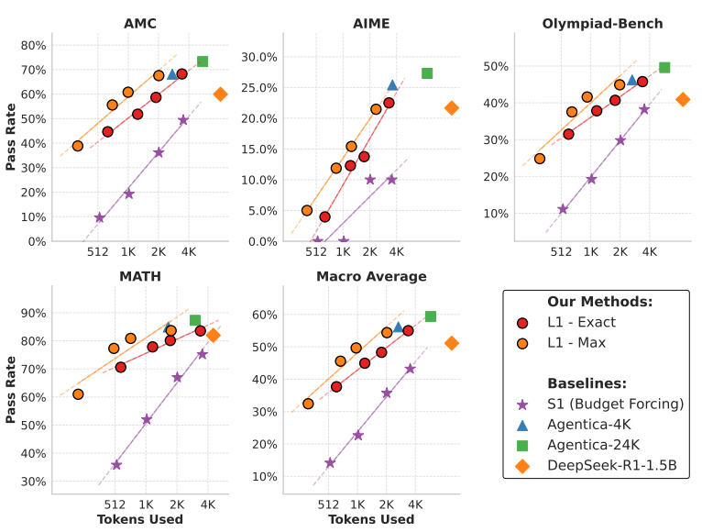
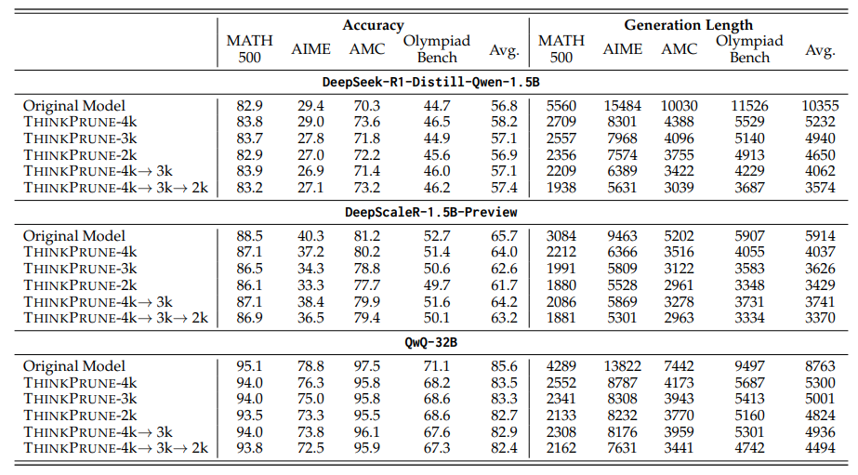
概览
Long2Short
On LRMs: online-RL
L1 (non-Adaptive): budget forcing + reward engineering:
ThinkPrune (non-Adaptive):
迭代 RL，逐渐收紧生成长度限制
两篇文章实验都很 solid，找不出问题（该方向绝大部分文章实验都有问题）
State Key Laboratory of Cognitive Intelligence
Notes:
L1: Aggarwal, Pranjal, and Sean Welleck. "L1: Controlling how long a reasoning model thinks with reinforcement learning." arXiv preprint arXiv:2503.04697 (2025).
ThinkPrune: Hou, Bairu, et al. "Thinkprune: Pruning long chain-of-thought of llms via reinforcement learning." arXiv preprint arXiv:2504.01296 (2025).

Slide 18
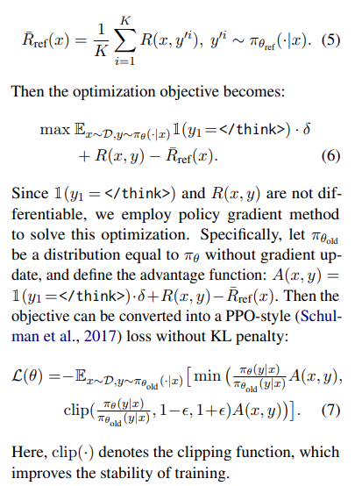
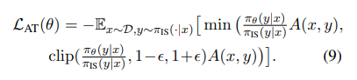
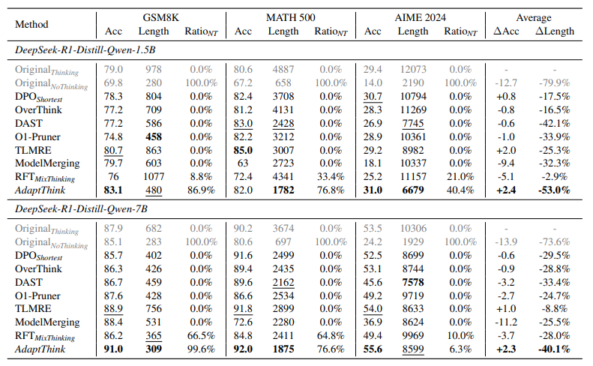
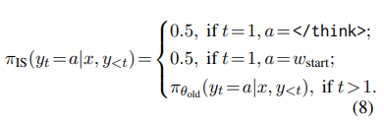
概览
Long2Short
On LRMs: online-RL
Adaptthink (Adaptive Thinking)
State Key Laboratory of Cognitive Intelligence
Notes:
Adaptthink: Zhang, Jiajie, et al. "Adaptthink: Reasoning models can learn when to think." arXiv preprint arXiv:2505.13417 (2025).

Slide 19
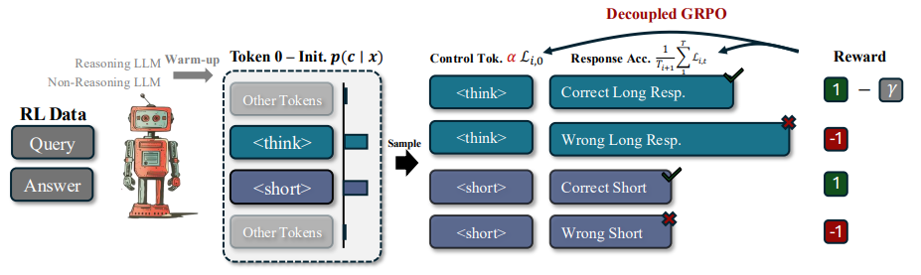
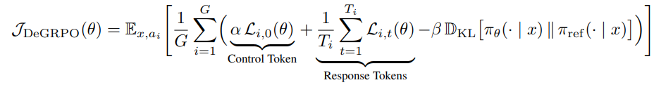
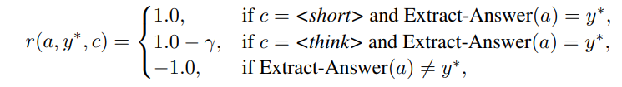
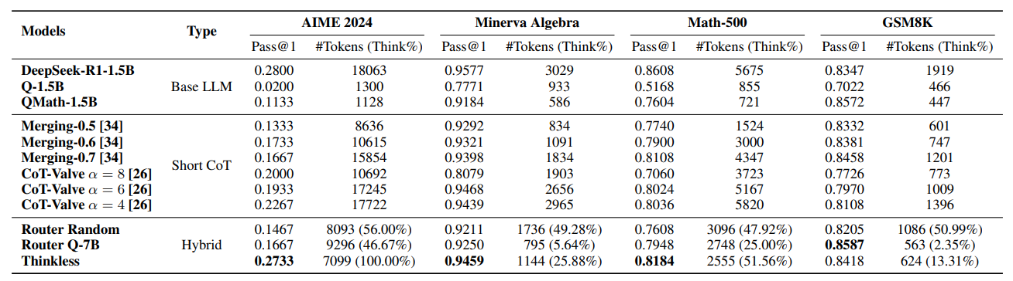
概览
Long2Short
On LRMs: online-RL
Thinkless (Adaptive Thinking)
State Key Laboratory of Cognitive Intelligence
Notes:
Thinkless: Fang, Gongfan, Xinyin Ma, and Xinchao Wang. "Thinkless: Llm learns when to think." arXiv preprint arXiv:2505.13379 (2025).

Slide 20
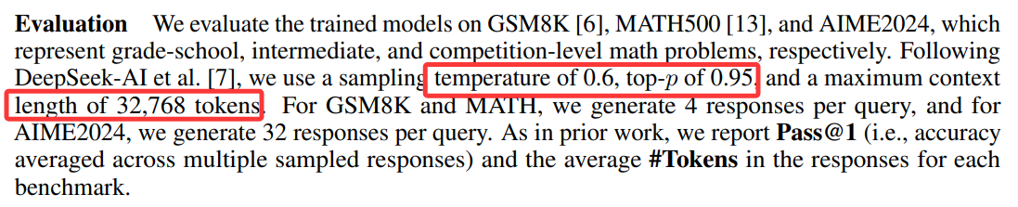
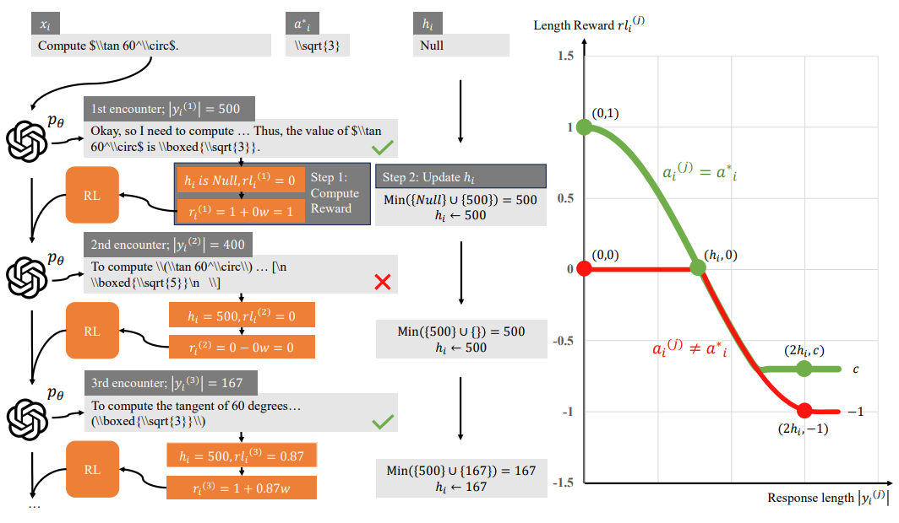
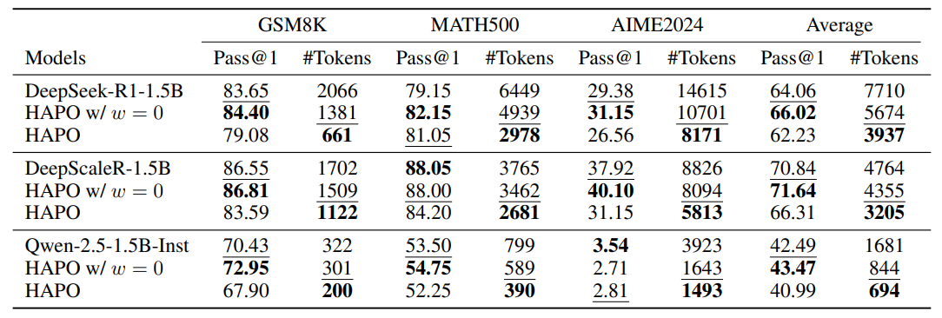
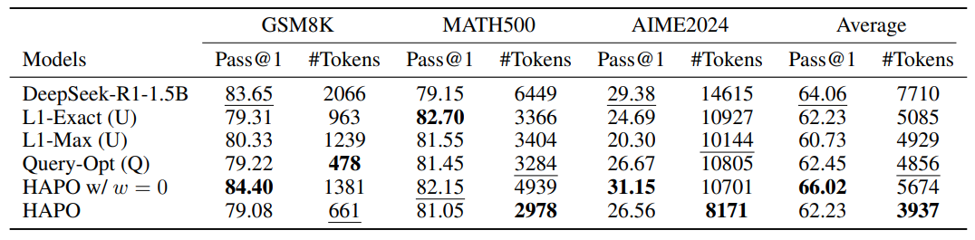
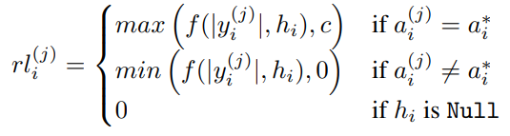
概览
Long2Short
On LRMs: online-RL
HAPO (non-Adaptive)
State Key Laboratory of Cognitive Intelligence
Notes:
HAPO:

Slide 21
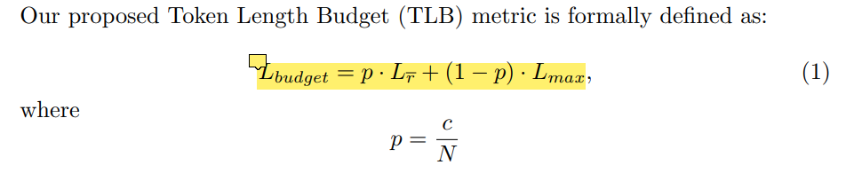
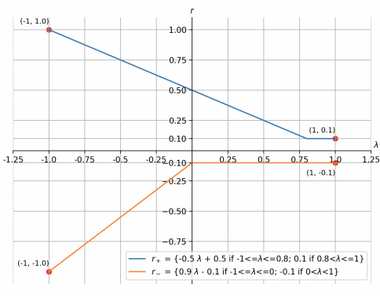
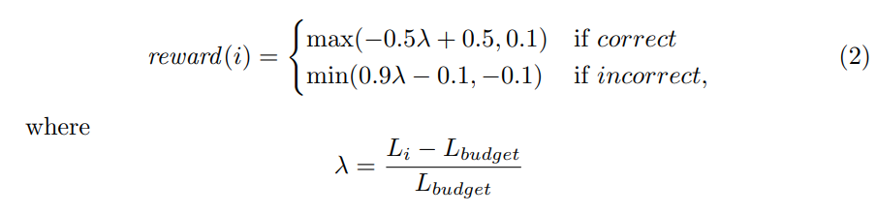
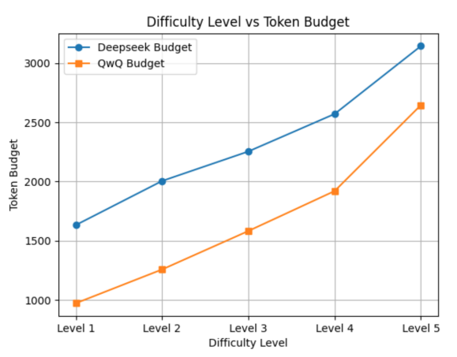
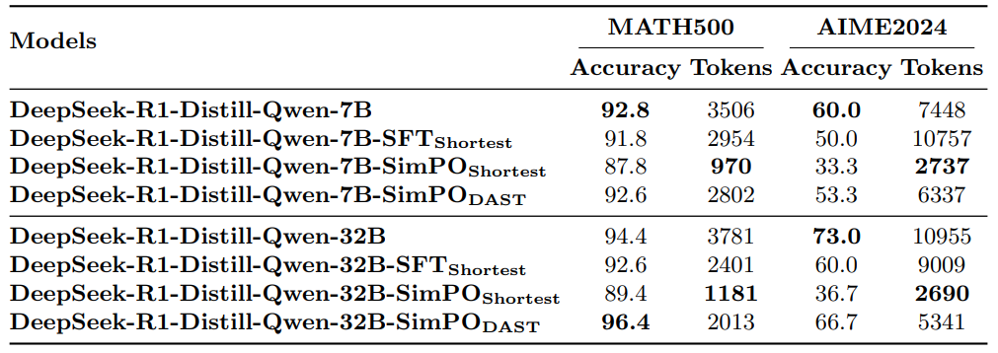
概览
Long2Short
On LRMs: offline-RL
DAST (non-Adaptive)
State Key Laboratory of Cognitive Intelligence
Notes:
DAST: Shen, Yi, et al. "Dast: Difficulty-adaptive slow-thinking for large reasoning models." arXiv preprint arXiv:2503.04472 (2025).

Slide 22
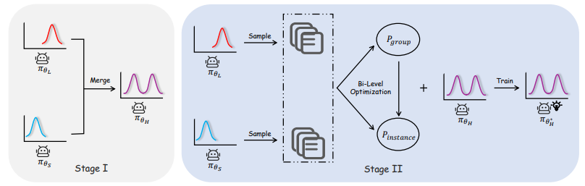
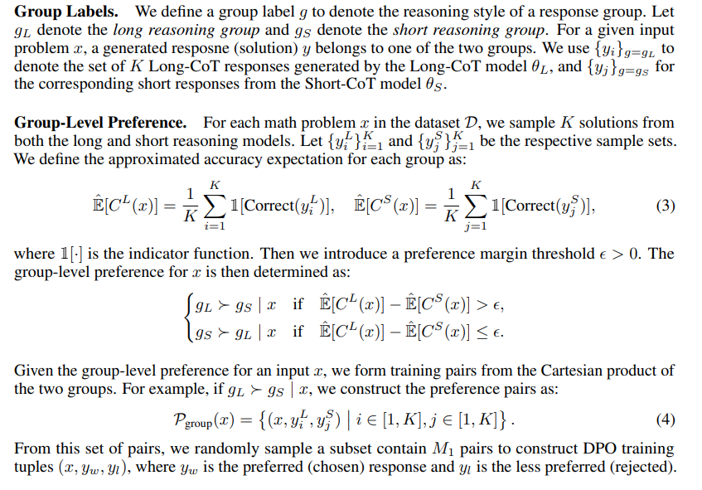
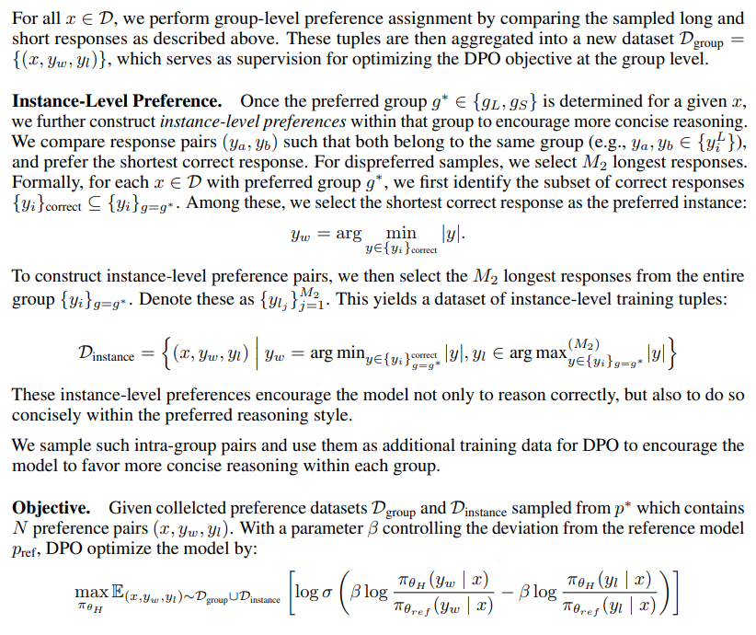
概览
Long2Short
其他：Model-Merging
Ada-R1 (Adaptive Thinking)
State Key Laboratory of Cognitive Intelligence
Notes:
Ada-R1: Luo, Haotian, et al. "Ada-R1: Hybrid-CoT via Bi-Level Adaptive Reasoning Optimization." arXiv preprint arXiv:2504.21659 (2025).

Slide 23
概览
Long2Short
其他：Model-Merging
Ada-R1 (Adaptive Thinking)
State Key Laboratory of Cognitive Intelligence
Notes:
Ada-R1: Luo, Haotian, et al. "Ada-R1: Hybrid-CoT via Bi-Level Adaptive Reasoning Optimization." arXiv preprint arXiv:2504.21659 (2025).

Slide 24
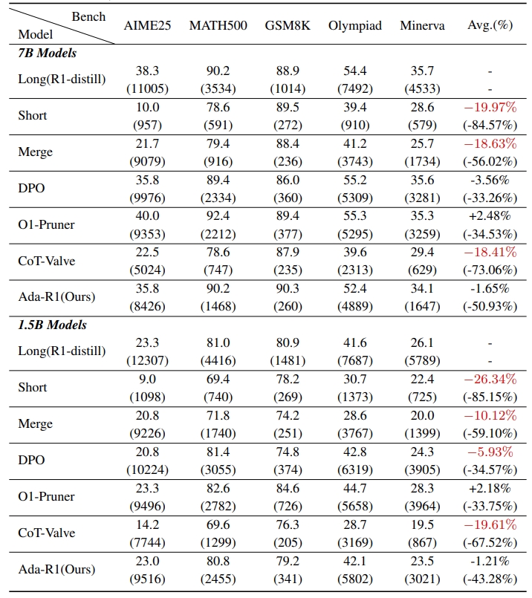
概览
Long2Short
其他：Model-Merging
Ada-R1 (Adaptive Thinking)
原文没有给出任何测评的 setting
这里的 AIME25 显然不是 accuracy
那么 采样次数是多少？
State Key Laboratory of Cognitive Intelligence
Notes:
Ada-R1: Luo, Haotian, et al. "Ada-R1: Hybrid-CoT via Bi-Level Adaptive Reasoning Optimization." arXiv preprint arXiv:2504.21659 (2025).

Slide 25
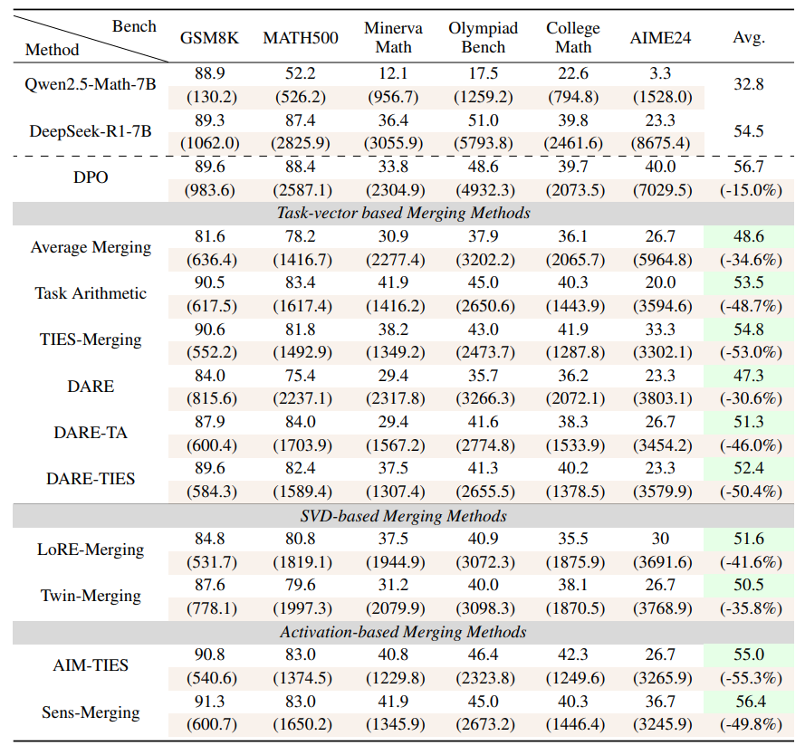
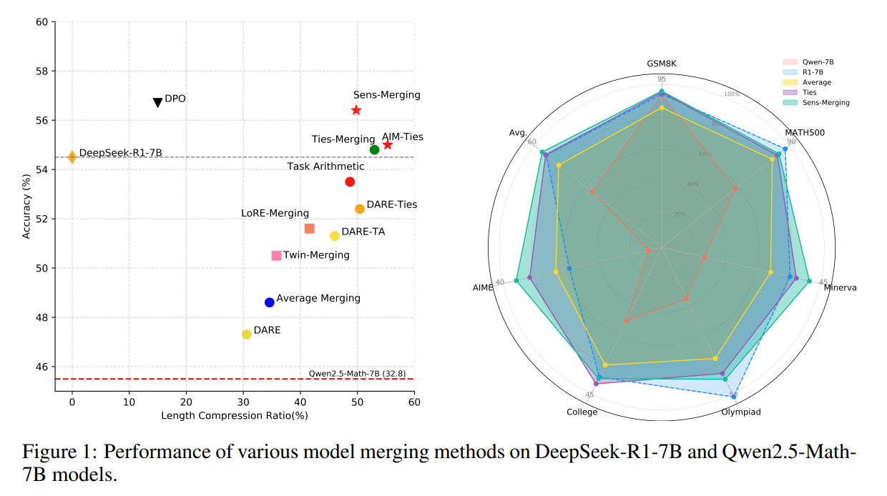
概览
Long2Short
其他：Model-Merging
(测评向？) (Adaptive Thinking)
State Key Laboratory of Cognitive Intelligence
Notes:
Wu, Han, et al. "Unlocking efficient long-to-short llm reasoning with model merging." arXiv preprint arXiv:2503.20641 (2025).

